Slide 1
Wow Technical Deliverable
ESG-443/SAP HANA Spark Controller
06-August-2019

Slide 2
Problem Statement
HanaDB Memory getting filled and Licenece is too costly.
Datavault Project – HanaDB big tables migrated to MapRDB JSON table using Sqoop. Hana Team has to do analytics on top of tables without transfering data between Hadoop & Hana.

Slide 3
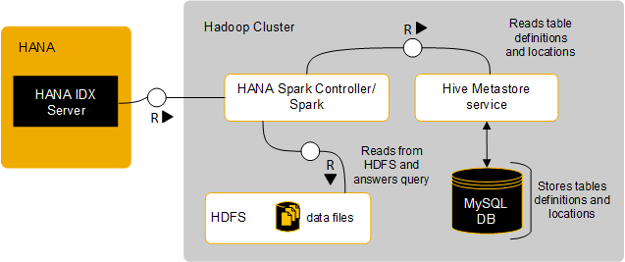
Solution Delivered/Implemented
SAP HANA Spark Controller –
Spark controller allows SAP HANA to access Hadoop data through the SQL interface and primarily works with Spark SQL to connect to an existing Hive metastore.
Spark Controller help to bring data back to Hana without sqoop/Manaul import in real time.

Slide 4
Installation of SAP HANA Spark Controller
Spark controller:
Is assembled, installed, and configured on a Hadoop cluster.
Facilitates data transfer between SAP HANA and Hadoop.
Facilitates query execution and enables SAP HANA to fetch data in a compressed columnar format.
Supports SAP HANA-specific query optimizations and secure communication.
Installation - rpm -i sap.hana.spark.controller-2.3.5-1.noarch.rpm

Slide 5
hanaes-site.xml
sap.hana.executor.count | 5
sap.hana.executor.memory | 3
sap.hana.es.port | 7862
sap.hana.es.hadoop.engine.facades | sparksql
spark.sql.hive.metastore.sharedPrefixes | org.apache.hadoop
sap.hana.es.enable.doAs | true
sap.hana.es.auditing.enabled | true

Slide 6
hana_hadoop-env.sh
export HADOOP_HOME=/opt/mapr/hadoop/hadoop-2.7.0/
export HADOOP_CONF_DIR=/opt/mapr/hadoop/hadoop-2.7.0/etc/hadoop/
export HIVE_CONF_DIR=/opt/mapr/hive/hive-2.1/conf
export HIVE_CONF_PATH=/opt/mapr/hive/hive-2.1/conf
export HANAES_SPARK_ASSEMBLY_JAR=/opt/mapr/spark/spark-2.2.1/jars/*
export HANAES_SPARK_ADDITIONAL_JARS=/opt/mapr/spark/spark-2.2.1/jars/datanucleus-api-jdo-4.2.4.jar:/opt/mapr/spark/spark-2.2.1/jars/datanucleus-core-4.1.6.jar:/opt/mapr/spark/spark-2.2.1/jars/datanucleus-rdbms-4.1.19.jar
export JAVA_HOME=/usr/lib/jvm/java-1.8.0-openjdk-1.8.0.161-0.b14.el7_4.x86_64/jre
export HADOOP_CLASSPATH=/opt/mapr/hadoop/hadoop-2.7.0/etc/hadoop:/opt/mapr/hadoop/hadoop-2.7.0/share/hadoop/common/lib/*:/opt/mapr/hadoop/hadoop-2.7.0/share/hadoop/common/*:/opt/mapr/hadoop/hadoop-2.7.0/share/hadoop/hdfs:/opt/mapr/hadoop/hadoop-2.7.0/share/hadoop/hdfs/lib/*:/opt/mapr/hadoop/hadoop-2.7.0/share/hadoop/hdfs/*:/opt/mapr/hadoop/hadoop-2.7.0/share/hadoop/yarn/lib/*:/opt/mapr/hadoop/hadoop-2.7.0/share/hadoop/yarn/*:/opt/mapr/hadoop/hadoop-2.7.0/share/hadoop/mapreduce/lib/*:/opt/mapr/hadoop/hadoop-2.7.0/share/hadoop/mapreduce/*:/contrib/capacity-scheduler/*.jar:/opt/mapr/lib/kvstore*.jar:/opt/mapr/lib/libprotodefs*.jar:/opt/mapr/lib/baseutils*.jar:/opt/mapr/lib/maprutil*.jar:/opt/mapr/lib/json-1.8.jar:/opt/mapr/lib/flexjson-2.1.jar:/opt/mapr/lib/maprfs-6.0.1-mapr.jar

Slide 7
Additional Jars:
hbase-common-1.1.1-mapr-1602.jar
maprfs-6.0.1-mapr.jar
scala-library-2.11.0-M1.jar
scala-pickling_2.11-0.11.0-M1.jar
trace-akka-2.2.4_2.10-0.1.4.jar
config-1.2.1.jar
akka-actor_2.11-2.3.4.jar
Link - https://search.maven.org/

Slide 8
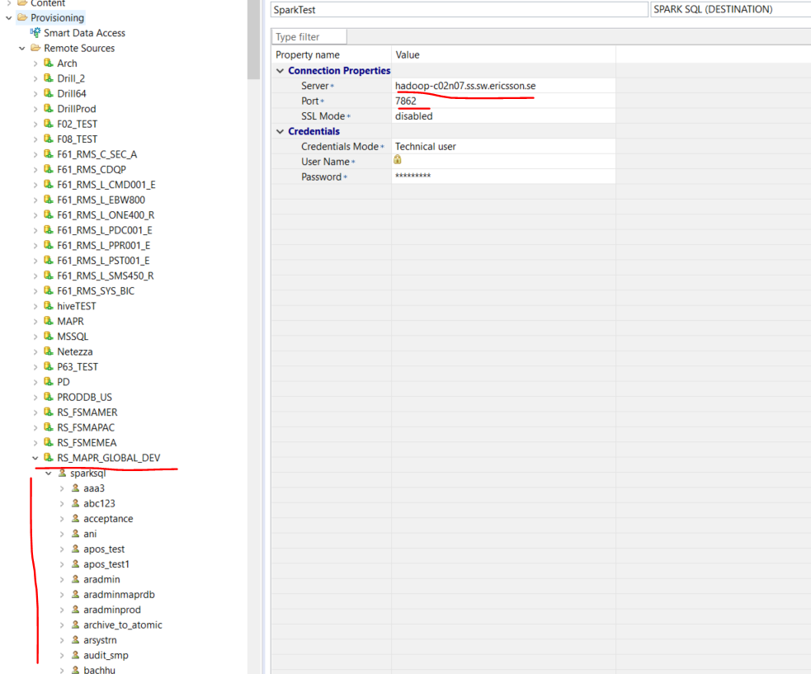

Slide 9
SELECT COUNT(*) FROM "C_SUP_A"."MAPR_DEV_cdpos_others";
Sample Hana Query.

